Slide 1
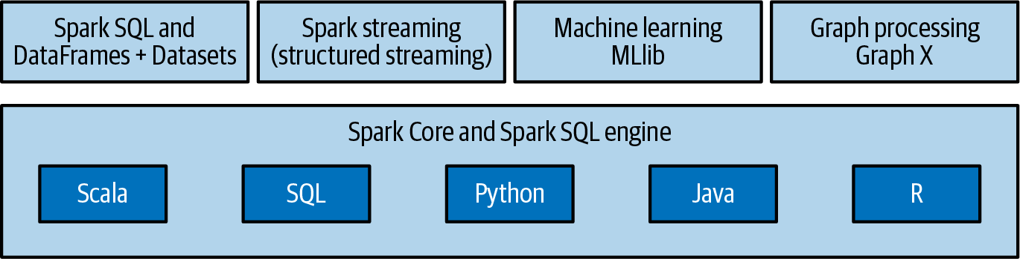
SPARK
Spark is a distributed, data-parallel compute engine.
Spark programming starts with a dataset, usually residing in some form of distributed, persistent storage like HDFS or a cloud-based solution such as AWS S3 and in a format like Parquet.
In the data-parallel model, more data partitions equals more parallelism.
In-memory cluster computing
Apache Spark claims that it can run certain data processing jobs up to 100 times faster than Hadoop MapReduce.
Spark has its own cluster management Spark uses Hadoop in two ways:
Storage
Processing
Spark 2.0 was released in 2017
Spark 3.0 was released in 2020 (+SparkSQL)
Note: For graph analytics, GraphFrames is recommended instead of GraphX, which isn’t being actively developed as much and lacks Python bindings.
Apart from the core computation engine (Spark Core), Spark is comprised of four main components:
This makes it easy to build scalable fault-tolerant streaming applications.
A scalable machine learning library.
GraphX is Apache Spark’s library for graphs and graph-parallel computation.
A module for working with structured data.
SparkSQL
A component on top of Spark Core that comprises a new data abstraction called SchemaRDD, which provides support for structured and semi-structured data.

Slide 2
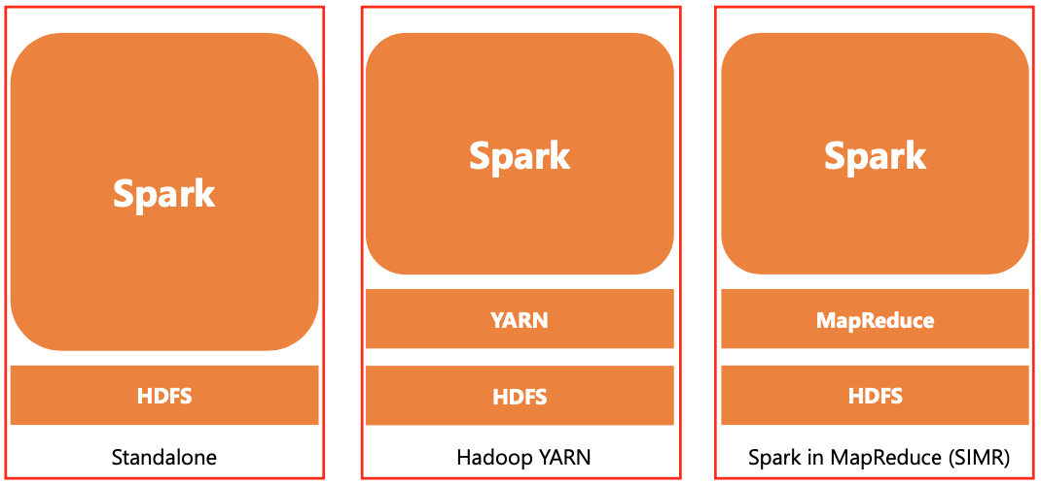
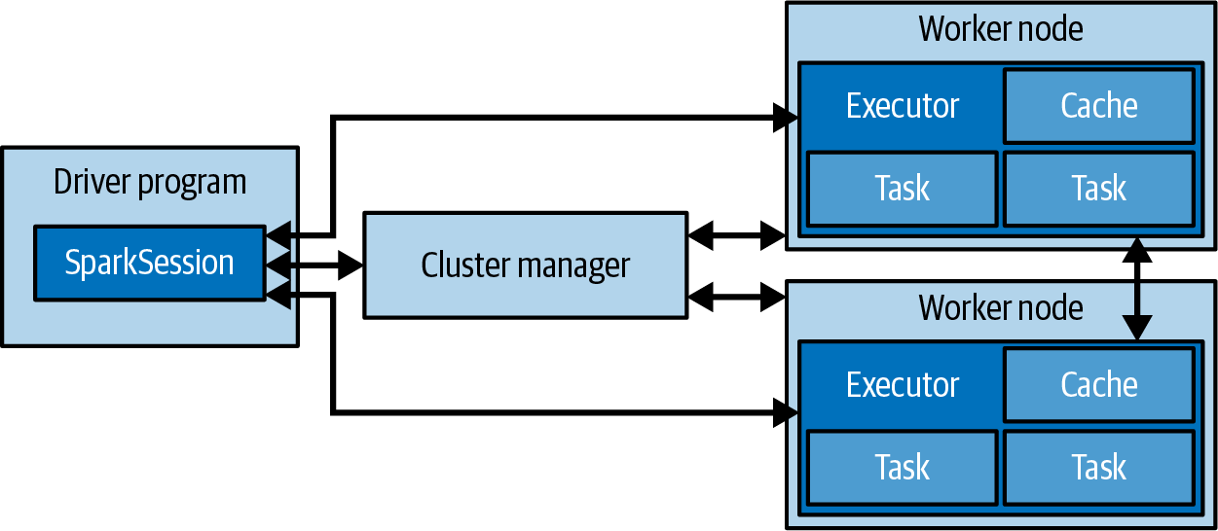
SPARK Architecture
SPARK DEPLOYMENT
SPARK APPLICATION
Spark application is comprised of:
a driver process
a cluster manager: manages resources
a set of executor processes.
The driver program is the central component and responsible for distributing tasks across executor processes.
Standalone deployment means Spark occupies the place on top of HDFS (Hadoop Distributed File System).
In this case, Spark and MapReduce will run side by side to cover all spark jobs on cluster.
Hadoop Yarn: Spark simply runs on Yarn without any pre-installation or root access required.
It helps to integrate Spark into Hadoop ecosystem or Hadoop stack.
Spark in MapReduce (SIMR) is used to launch Spark job in addition to standalone deployment.
User Code
Figure: Spark architecture diagram

Slide 3
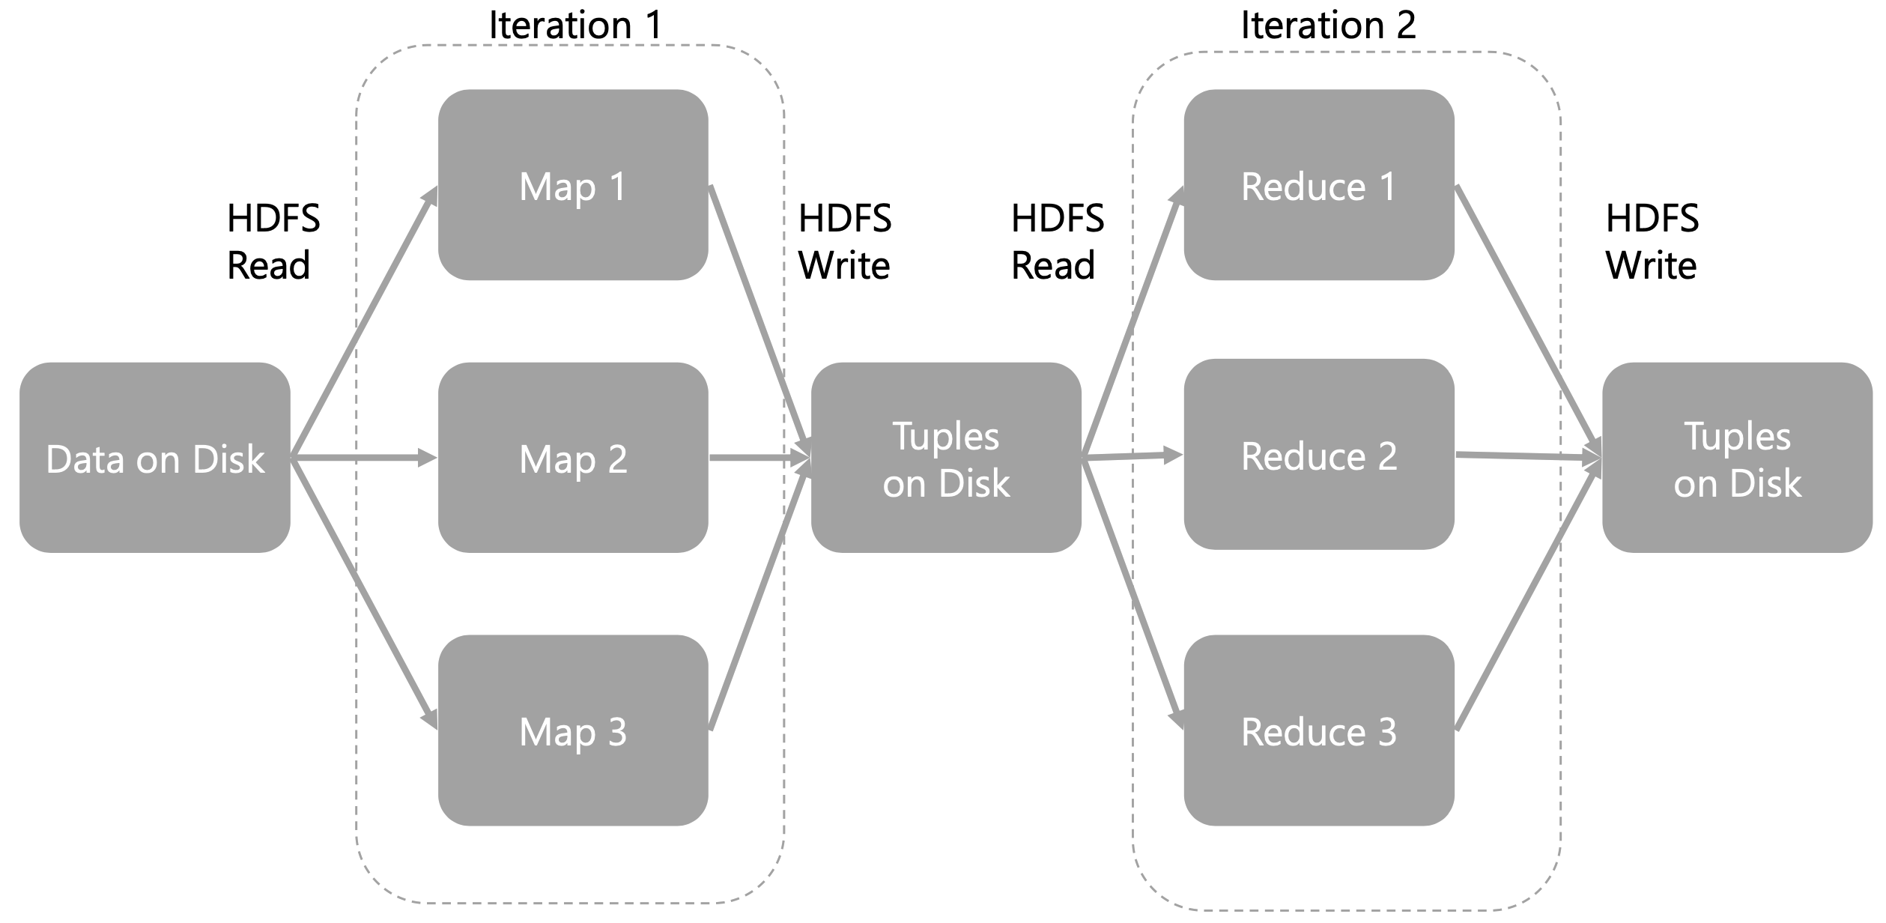
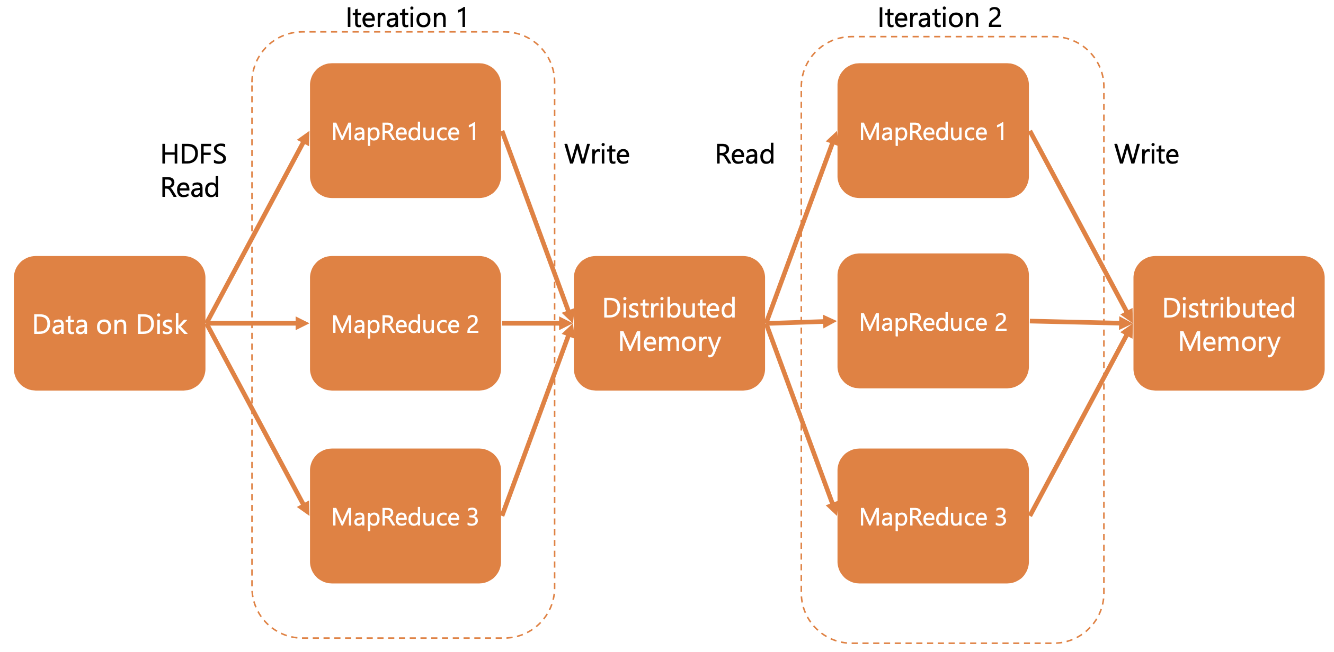
SPARK Architecture
DATA SHARING
Spark RDDs
Spark RDDs
Resilient Distributed Dataset (RDDs) are created from input data set using some parsing on input data and then using map or filter transformations on that data
This forms the lineage of the RDD.
If this RDD was lost, then it can be recreated by re-running map/filter transformations on input data.
Thus, RDDs can only be created by running transformations on disk data or by transforming other RDDs
RDDs are immutable which makes recovery easier —the system doesn’t need to worry about maintaining a log of operations that tracks the individual changes within an RDD.
Reuse data between computations (between two MapReduce jobs) is to write it to an external stable storage system (e.g. HDFS).
MapReduce is slow due to replication, serialization, and disk IO
In fact, Hadoop applications spend more than 90% of the time performing HDFS read-write operations.
Map Reduce
Spark

Slide 4
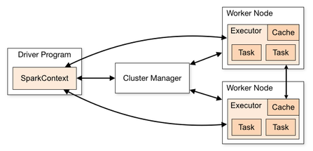





SPARK Architecture
DATA STRUCTURE
RDDs: (Resilient Distributed Datasets)
core building blocks of datasets
an immutable, partitioned collection of records
used in lineage graphs for fault tolerance capability
no schema (just recorded row-by-row, similar to a list)
DataFrames: have all features of RDD but also have schema (like a relational DB) -> can be used with PySpark
DataSets: similar to DataFrames, but strongly typed (validate data types of all columns. The dataset API is available only in Scala and Java only
vs MapReduce
Caching intermediate data in memory (MapReduce save them to HDFS – because it’s multiple rounds of MR) -> reduce disk I/O
RDD concept: to tell the memory to re-use
More flexible model, supporting more operations (MR fixed the programming design to just Map & Reduce)
PROCESS
Worker Node
Worker Node
Worker Node
Worker Node
Driver creates SparkContext, which is essentially an orchestrator that considers the code and determines the possible Tasks to be performed.
It generates a physical plan and then uses the Cluster Manager to coordinate all Executors to the schedule and run the Tasks.
Scheduler within SparkContext is a DAG, which will assign Tasks and order to execute them out to Worker Nodes.
Executors residing in Worker Nodes are dynamically launched by Cluster Manager. They run their tasks and return the result to the Driver.
Input Data Partitions stored in different HDFS workers
Spill
HDFS
TB
Disks
read()
Serialize
Read & map the input record by record
NARROW Operations: super efficient as it is down locally
map()
2020: 19
2021: 28
2020: 39
2021: 18
Shuffle
distinct()
WIDE
Operations: move things around workers. Heavy weight
2020: 39
2021: 28
groupByKey()
groupByKey() is also a wide operation, but since distinct() already done the shuffle, so groupByKey() can be done without shuffle expense as Spark computes & optimizes Lineage Graph first before starting
collect()

Slide 5
SPARK Architecture
FAULT-TOLERANT
Driver Program: Spark does not replicate the driver machine
Worker: if a worker fails, Spark will need to re-compute the data partition on the failing worker via other workers (as other workers might hold the replica of the partition) & can perform parallel computing for faster processing
Worker fails in WIDE dependencies: in this case, when the failing worker re-compute in WIDE transformation, it might requires the inputs from the other alive workers, but the other alive worker already discard the output of previous stage as they finished WIDE transformation ?? WHAT TO DO ??
Solution: save the intermediate result of proceeding stages into HDFS, so if there is a wide transformation, there is no-need to re-compute for all partitions again.

Slide 6

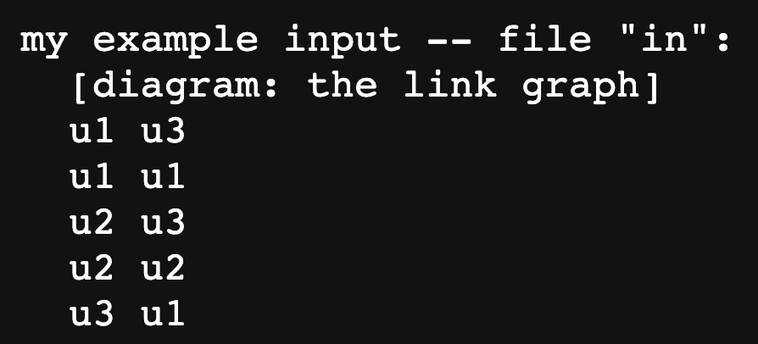


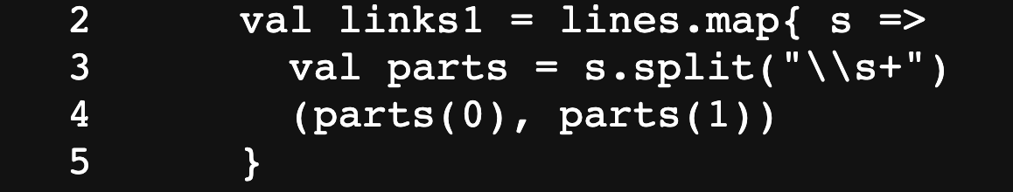
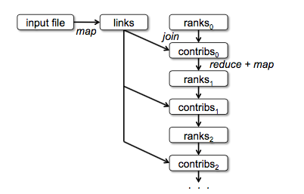




SPARK Example
This code is not reading the file. Instead, it build a lineage graph (computation recipe)
Computation only happens when we start actions like collect()
In this example, when collect() is called, Spark will figure out where the data is store in HDFS, pick a set of workers to run, process different partitions, send the byte codes to worker machines, collect back the result from the workers
cache(): keep links4 for in the cache memory as will be used frequently
Page Rank’s graph lineage grows with every iteration as RDDs are immutable and new ranks, contribs RDDs get created
Map(): define function to process for each line of the input
Distinct(): require communication between workers to shuffle the data
groupByKey(): require communication, but Spark will optimize since Distinct() already put the records with the same keys on the same workers

Slide 7
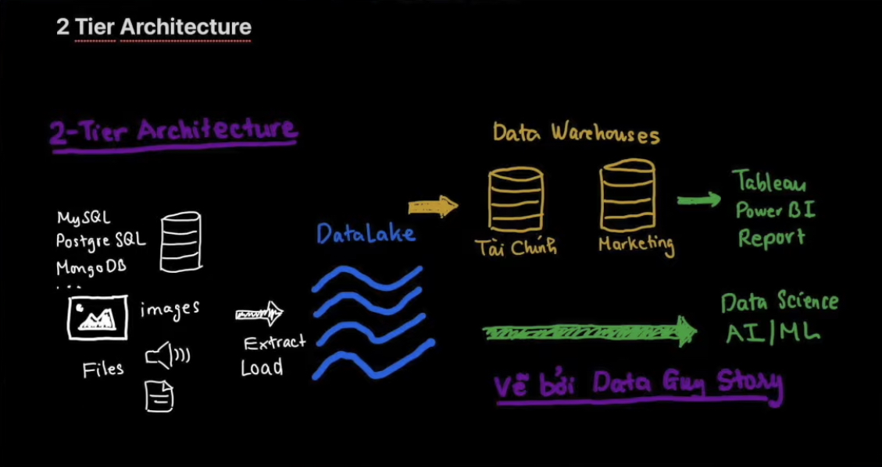
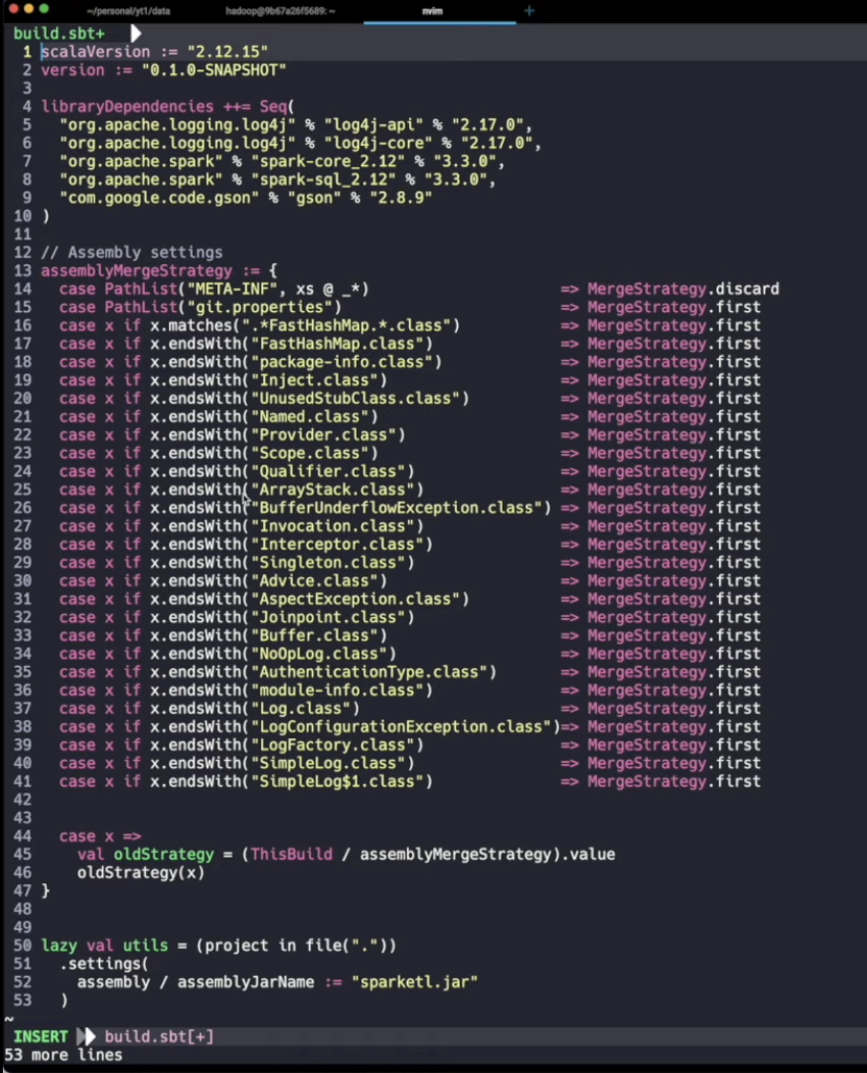
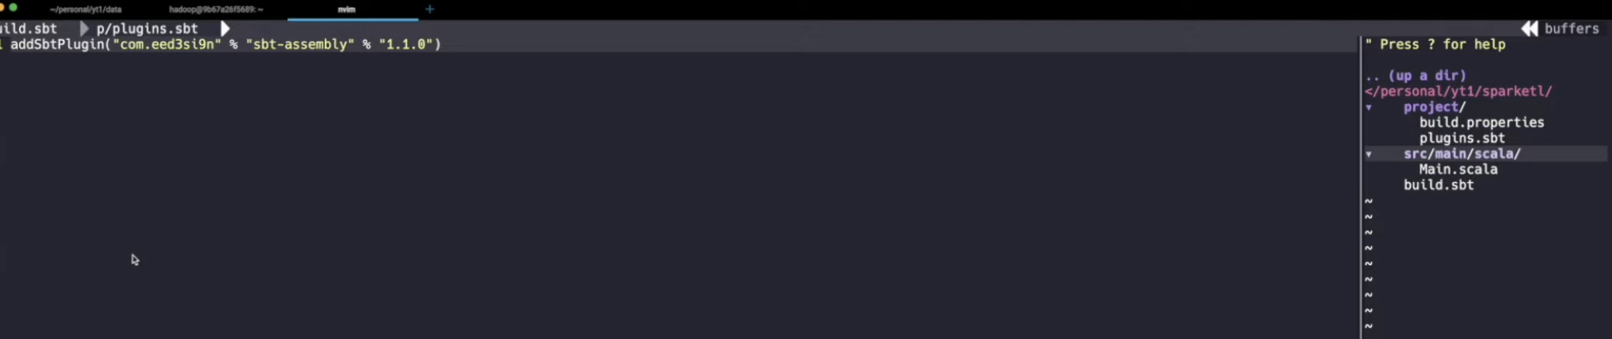
SPARK ETL Example
Builds.sbt: rules when project being compiled

Slide 8
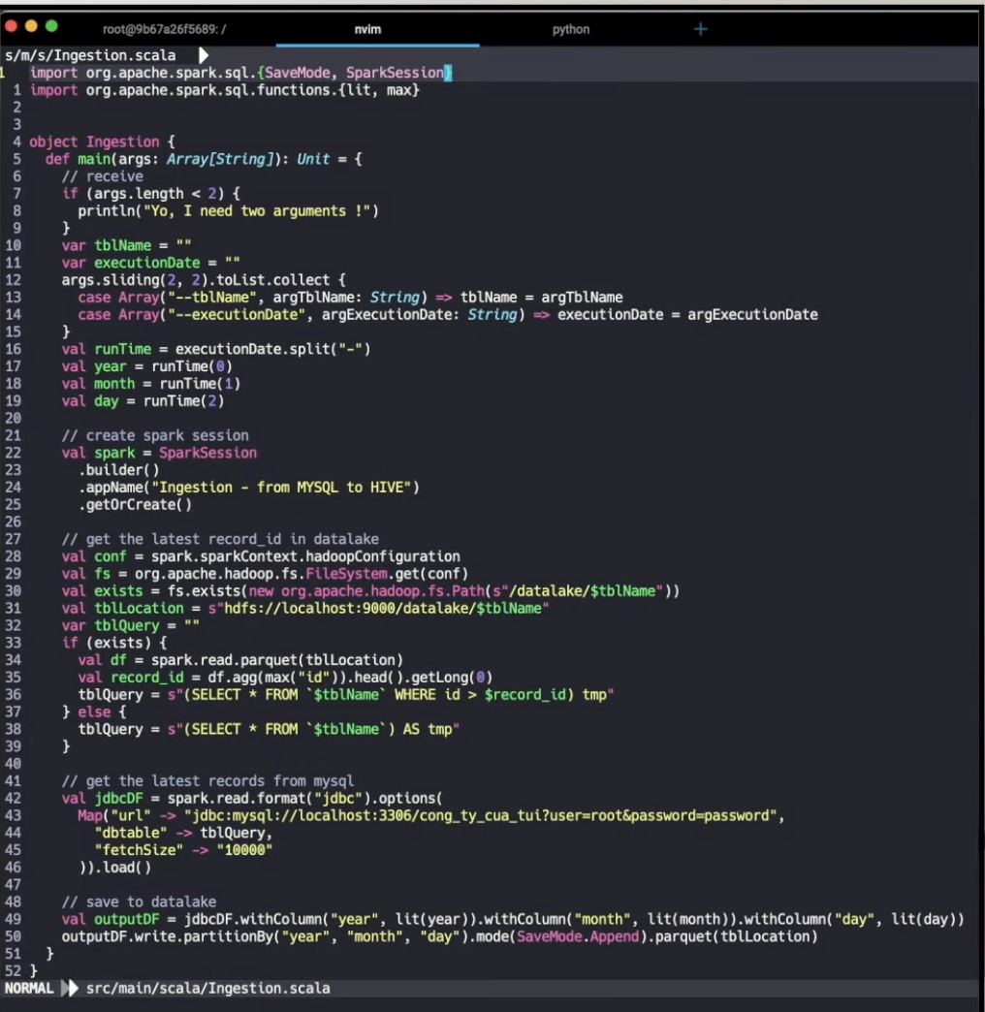
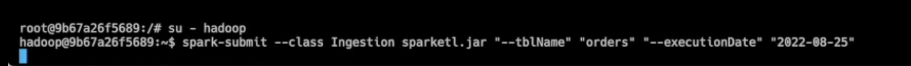
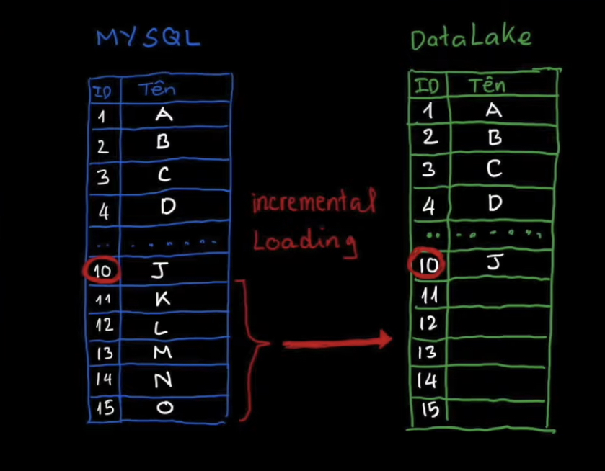
SPARK ETL Example
Ingestion.scale: Data Ingestion from SQL to Data Lake
Spark Submit: table name + execution day (use for data partition in data lake)
Ingestion:
Spark sessions
Incremental loading: The ingestion pipeline will try to get the latest data at the end of the day from mysql and put into data lake. How: get the latest data in the data lake, in this case is row 10, and compare with data from mysql, in this case is row 10 to 15. Save to hadoop hdfs

Slide 9
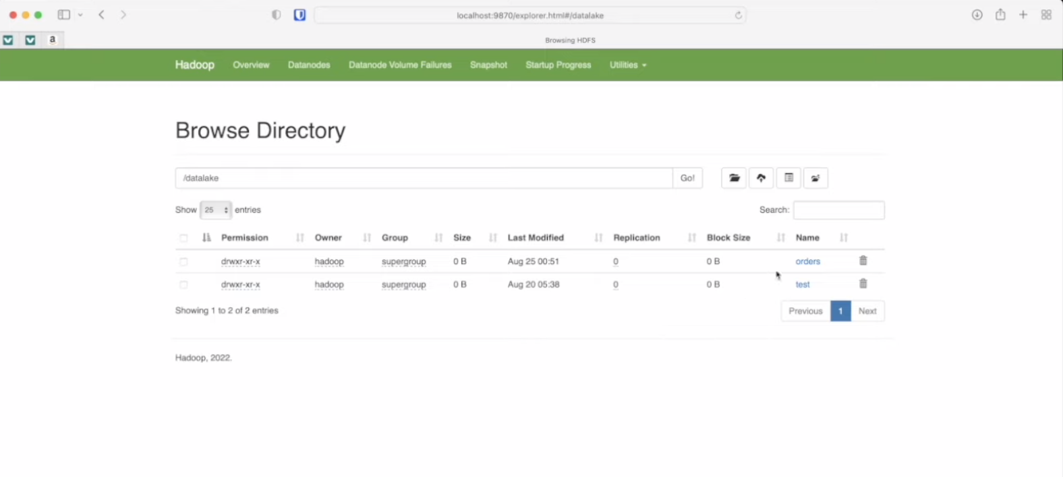
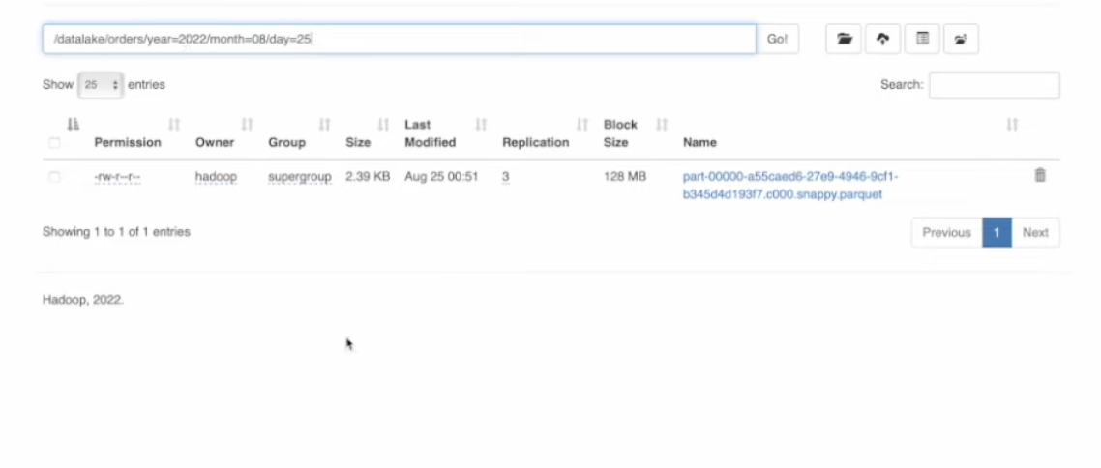
SPARK ETL Example

Slide 10
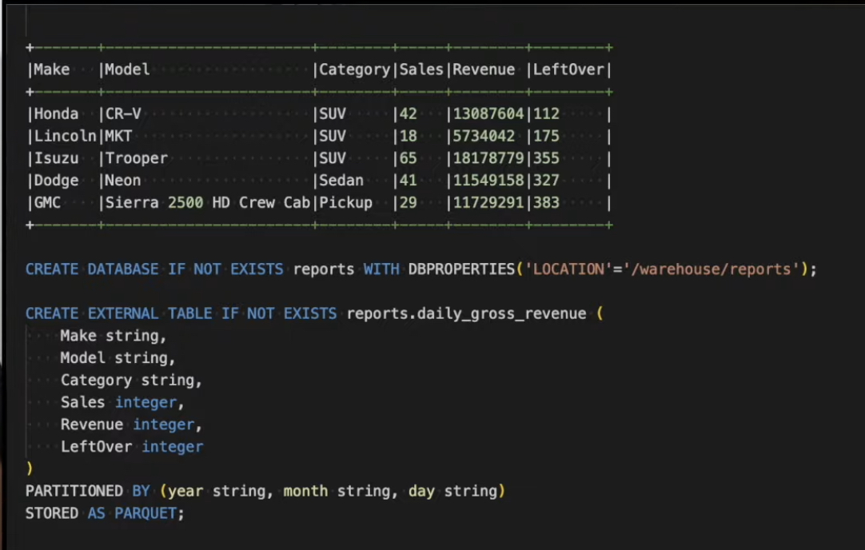
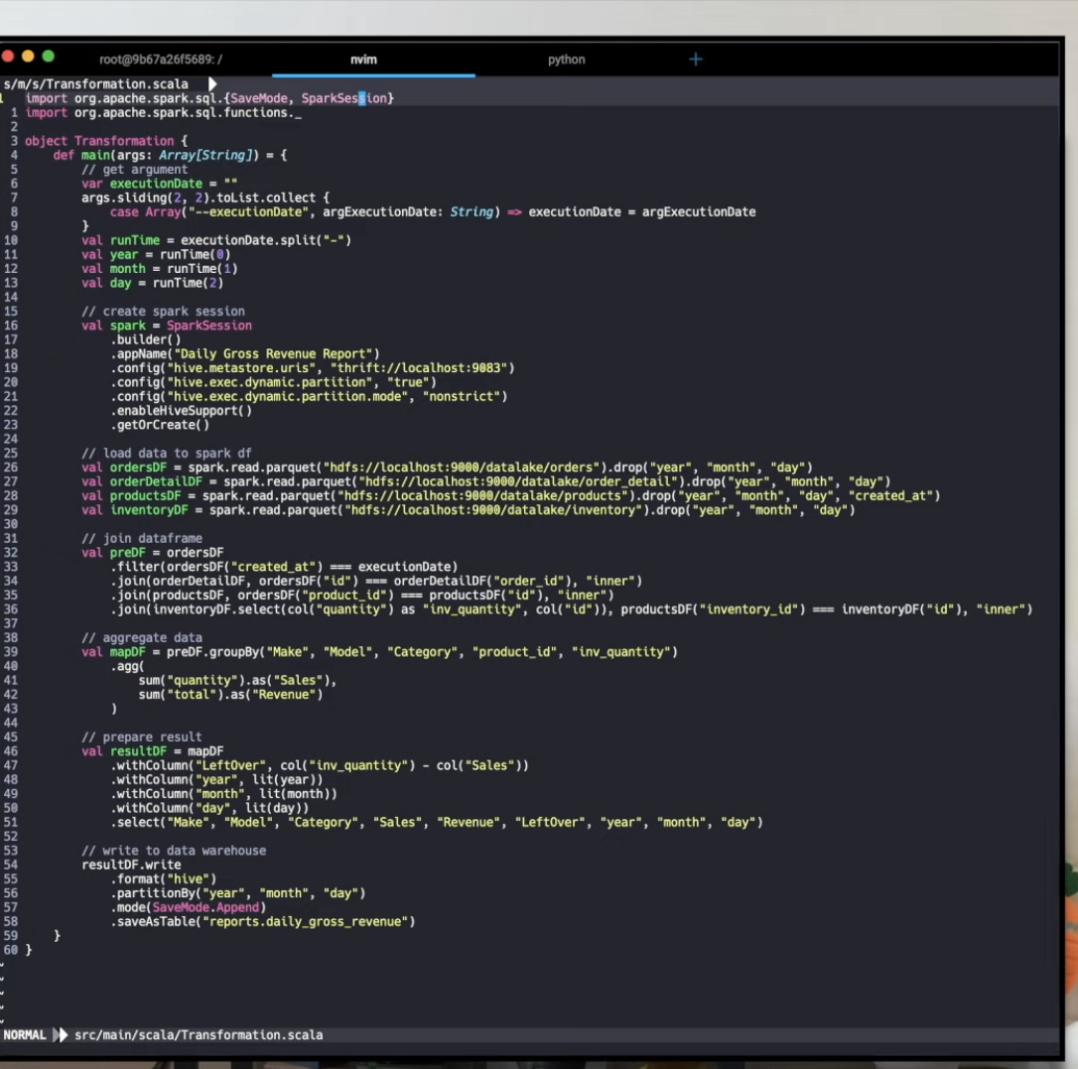
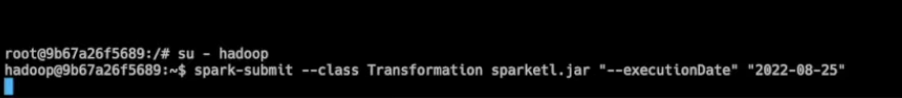
SPARK ETL Example
Transforms:
Spark session linked with Hive (since data warehouse → need hive) Relational
Note: not directly save data into HDFS, but needs to store via Hive, then Hive to Hdfs. Data → Spark - Hive → hdfs. Hive only stores metadata like table names, columns. The reason needs Hive because we want to querry the data
Load data from datalake into spark data frame
Perform transform
Save sparkdf to hive table
Notes:
Data Transform

Slide 11
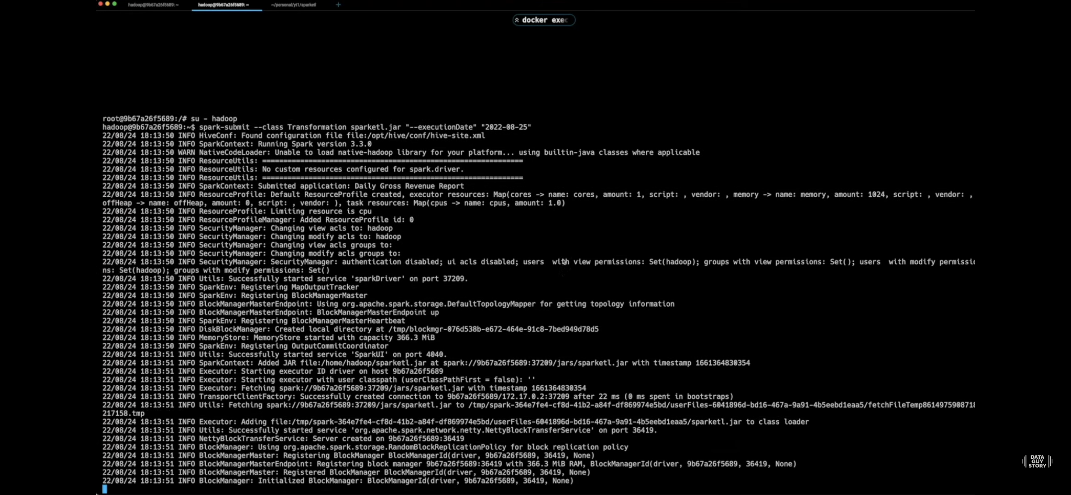
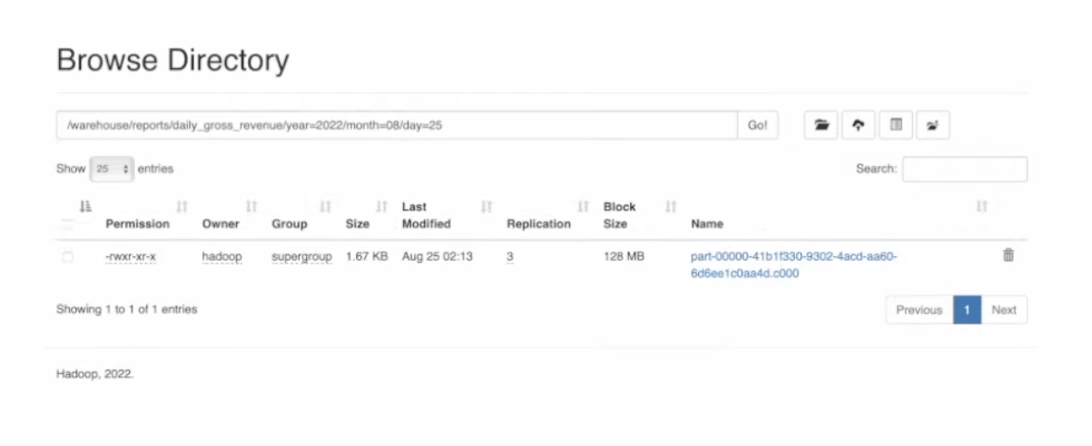
SPARK ETL Example
Notes:
Data Transform

Slide 12
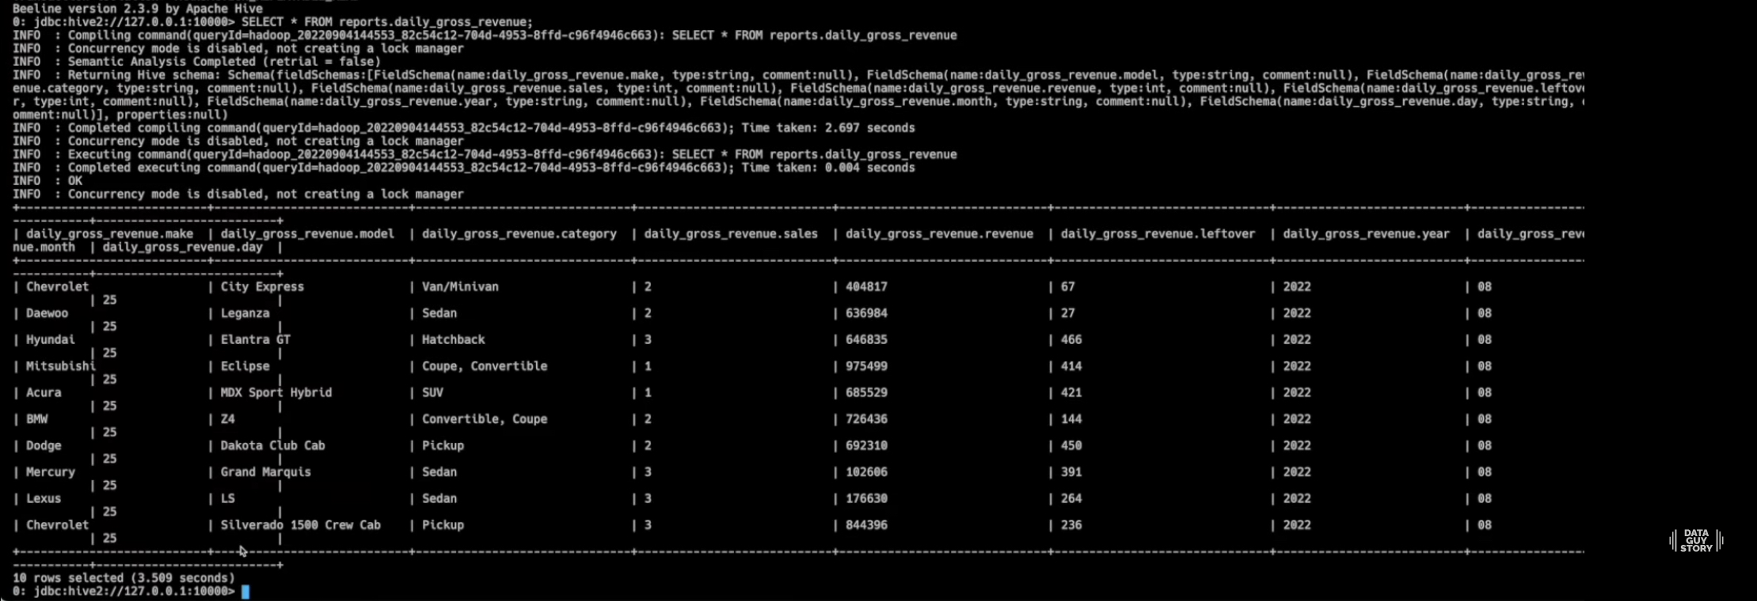
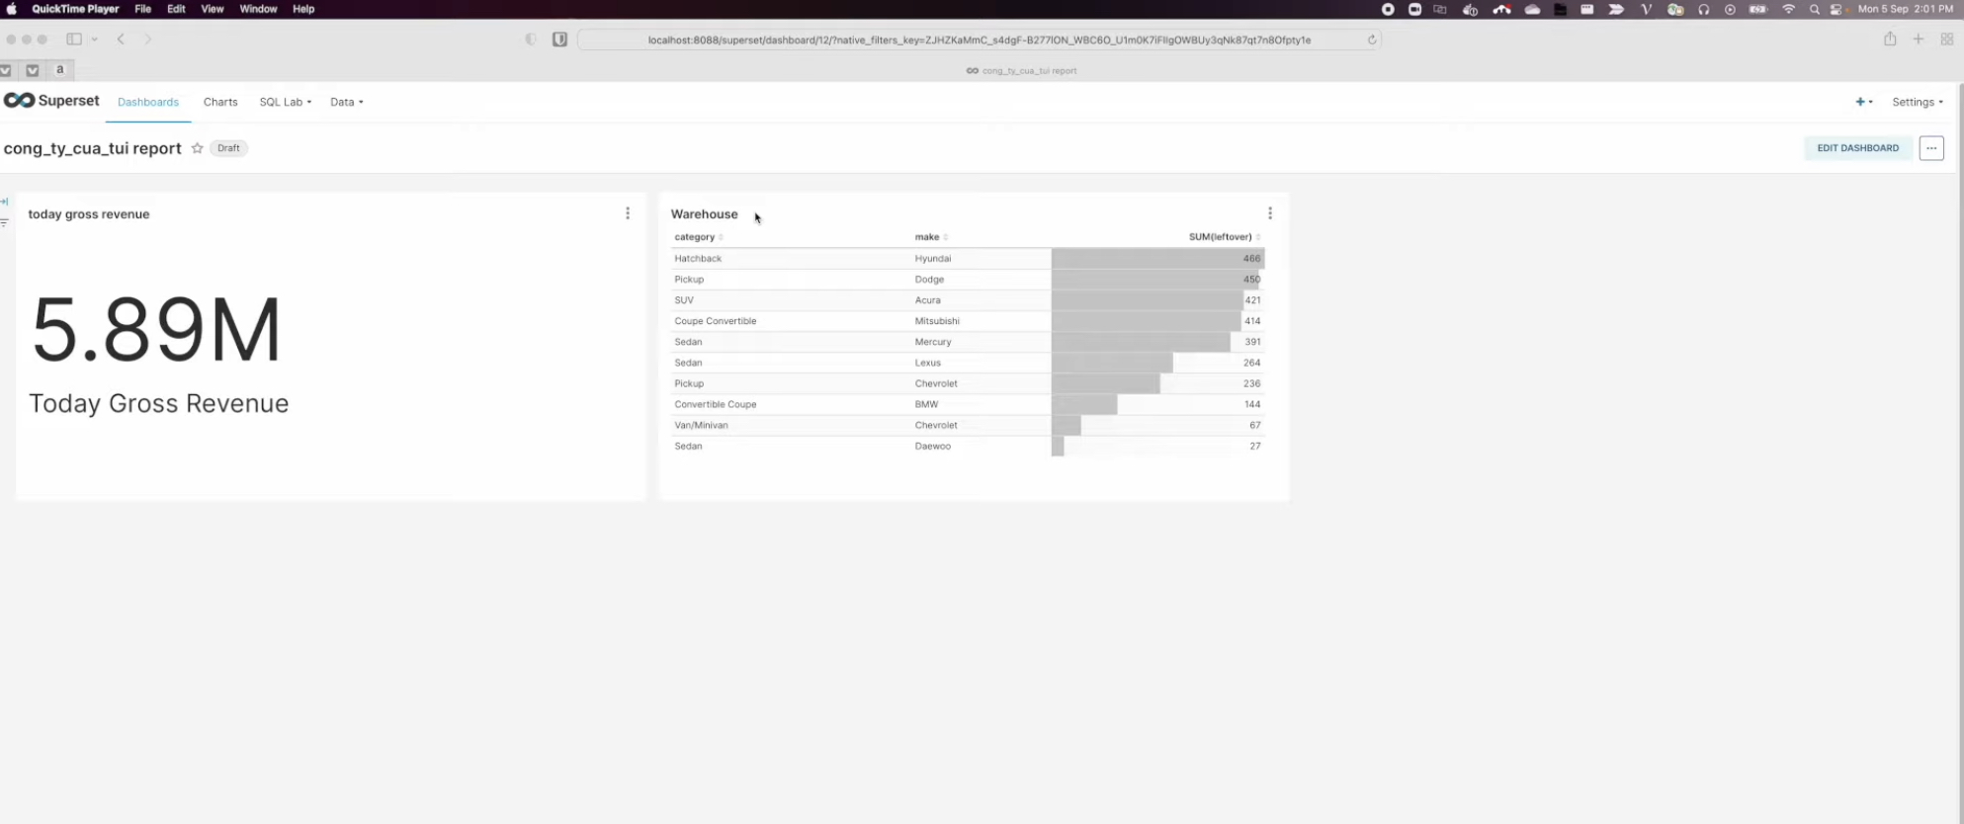
SPARK ETL Example
Notes:
DataFrame: Data Wrangling => Data Analysis (group_by, apply)
ETL: Example of ETL Pipeline, how do we create the Pipeline

Slide 13
PySPARK
PySpark is a Python-based wrapper over the core Spark framework, which is written primarily in Scala.
PySpark allows us to work across programming models.
For example, a common pattern is to perform large-scale extract, transform, and load (ETL) workloads with Spark
Then collect the results to a local machine followed by manipulation using pandas.
DATAFRAME AND RDDS
DataFrame is an abstraction for datasets that have a regular structure in which each record is a row made up of a set of columns, and each column has a well-defined data type.
distributed datasets on a cluster
NOT the same as pandas.DataFrame
Notes:
Deeper DataFrame vs RDDs: https://learning.oreilly.com/library/view/learning-spark-2nd/9781492050032/ch03.html#key_merits_and_benefits

